Slide 1
Session 18 : WebKit Browser
Module 4.3 : Android

Slide 2
Learning Objectives
At the end of the session successful participants will be able to
Embed the built‐in Web browser
Understand Android WebKit
Create app to embed web browser in Android application

Slide 3
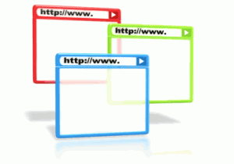


WebKit Browser
Introduction
In Android you can embed the built‐in Web browser as a widget in your own activities, for displaying HTML material or perform Internet browsing.

Slide 4
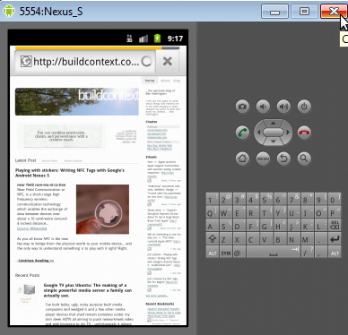
WebKit Browser
Introduction
The Android browser is based on WebKit, the same engine that powers Apple's Safari Web browser.

Slide 5
WebKit Browser
Introduction
The Android browser is based on WebKit, the same engine that powers Apple's Safari Web browser.
WebKit
Android
Apple Safari

Slide 6
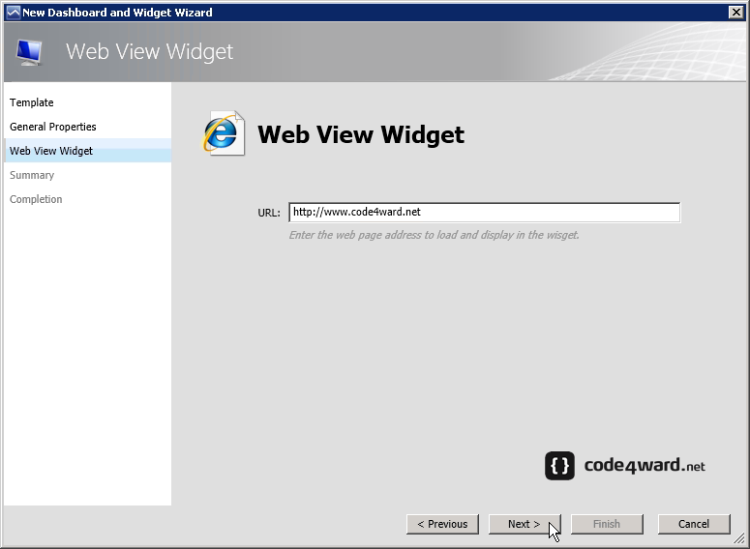
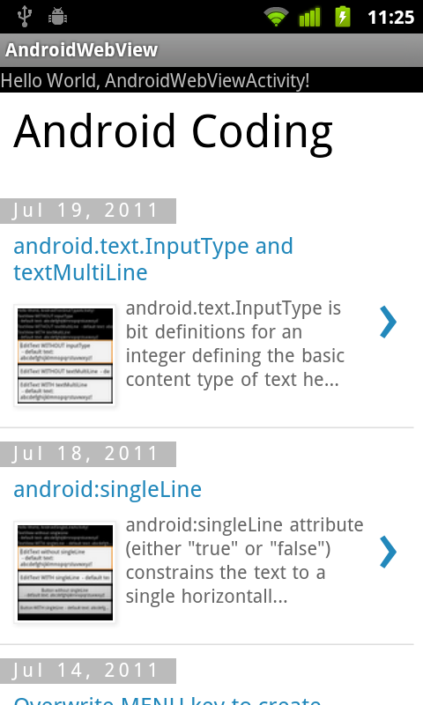
WebKit Browser
Introduction
Android uses the WebView widget to host the browser’s pages
Applications using the WebView component must request
INTERNET permission.

Slide 7
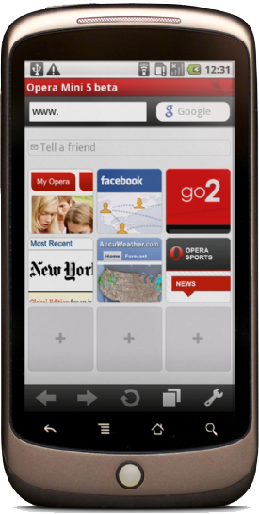
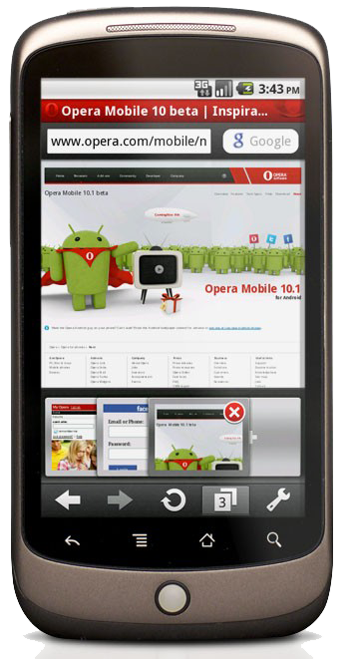
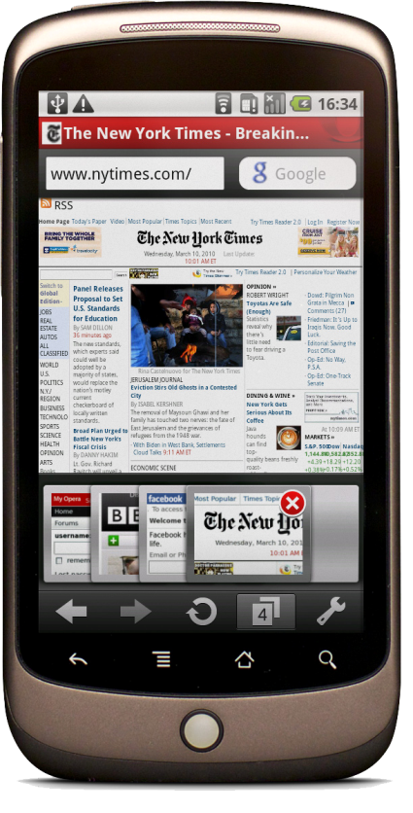
WebKit Browser
Browsing Power
The browser will access the Internet through whatever means
are available to that specific device at the present time (WiFi,
cellular network, Bluetooth‐tethered phone, etc.).

Slide 8
WebKit Browser
Browsing Power
The WebKit rendering engine used to display web pages includes methods to:
Navigate forward and backward through a history
Zoom in and out
Perform text searches
Load data
Stop loading etc.

Slide 9

WebKit Browser
Warning
In order for your Activity to access the Internet and load web pages in a WebView, you must add the INTERNET permissions to your Android Manifest file:
Add INTERNET permissions to Manifest file
<uses-permission android:name="android.permission.INTERNET" />
This must be a child of the manifest> element.

Slide 10
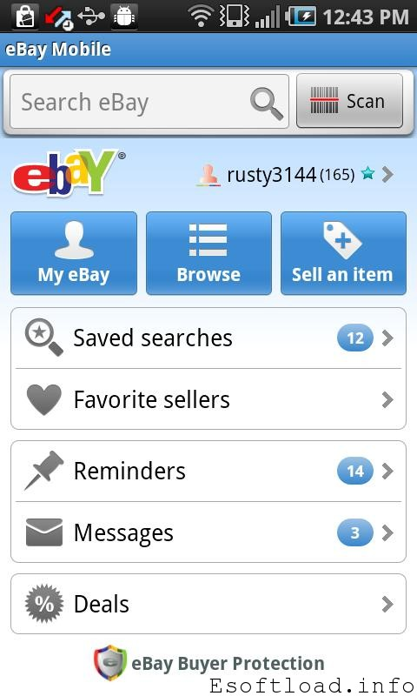
WebKit Browser
Warning
Example: A simple browsing experience. Let’s go e‐shopping
<?xml version="1.0" encoding="utf-8"?>
<LinearLayout
xmlns:android="http://schemas.android.com/apk/res/android"
android:orientation="vertical"
android:layout_width="fill_parent"
android:layout_height="fill_parent”>
<WebView
android:id="@+id/webkit"
android:layout width="fill parent“
android:layout_height="fill_parent”/>
</LinearLayout>

Slide 11
WebKit Browser
Warning
Example: A simple browsing experience. Let’s go e‐shopping
package cis493 demoui;
import android.os.Bundle;
import android.app.Activity;
import android.webkit.WebView;
public class AndDemoUI extends Activity {WebView browser;
@Override
public void onCreate(Bundle icicle) {
super.onCreate(icicle);
setContentView(R.layout.main);
browser=(WebView)findViewById(R.id.webkit);
browser.loadUrl("http://eBay.com");
browser.getSettings().setJavaScriptEnabled(true);}}

Slide 12
WebKit Browser
Warning
Example: A simple browsing experience Let’s go e‐shopping - Manifest
<?xml version="1 0" encoding="utf-8"?>
<manifest xmlns:android="http://schemas.android.com/apk/res/android"
package="cis493.demoui" android:versionCode="1" android:versionName="1.0">
<uses-permission android:name="android.permission.INTERNET" />
<application android:icon="@drawable/icon" android:label="@string/app_name">
<activity android:name=".AndDemoUI" android:label="@string/app_name">
<intent-filter>

Slide 13
WebKit Browser
Warning
Example: A simple browsing experience Let’s go e‐shopping - Manifest
<action android:name="android.intent.action.MAIN" />
<category android:name="android.intent.category.LAUNCHER" />
</intent-filter>
</activity>
</application>
<uses-sdk android:minSdkVersion="3" />
</manifest>

Slide 14
WebKit Browser
Warning
If you set the URL to a site whose pages depend on Javascript you may see an empty, white screen.
By default Javascript is turned off in WebView widgets.
If you want to enable Javascript, call on the WebView instance.
myWebView.setSettings().setJavaScriptEnabled(true);

Slide 15
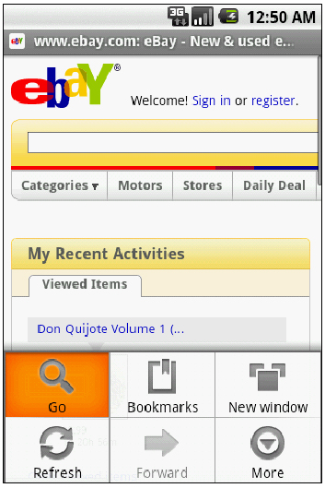
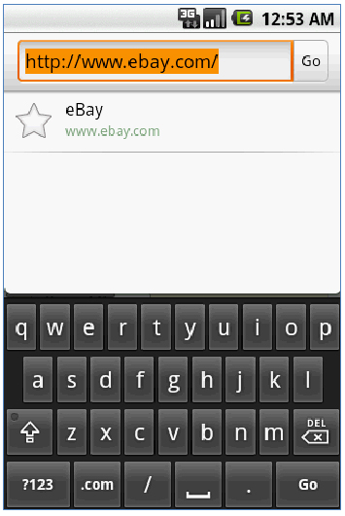
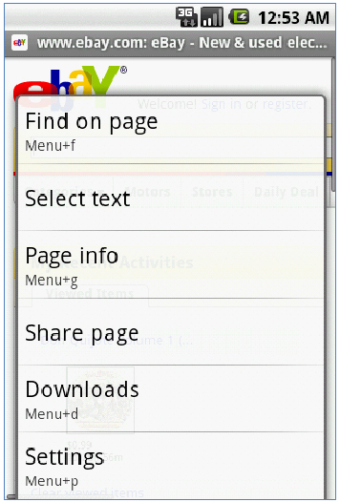
WebKit Browser
Warning
Under SDK 1.6 a WebView has a built‐in Option Menu
Using “Go” option
Using “More” option

Slide 16

WebKit Browser
Loading Data .loadData(…)
You may directly provide the HTML to be displayed by the browser
(a user manual for instance, or the actual app interface created as HTML instead of using the native Android UI framework).
package cis493.demoui;
import android.os.Bundle;
import android.app.Activity;
import android.webkit.WebView;
public class AndDemoUI extends Activity {
WebView browser;
@Override
public void onCreate(Bundle icicle) {

Slide 17
WebKit Browser
Loading Data .loadData(…)
You may directly provide the HTML to be displayed by the browser
(a user manual for instance, or the actual app interface created as HTML instead of using the native Android UI framework).
Use same layout and manifest of previous example
super.onCreate(icicle);
setContentView(R.layout.main);
browser=(WebView)findViewById(R.id.webkit);
browser.loadData("<html><body>Hello, world!</body></html>",
"text/html",
"UTF-8");}}

Slide 18
WebKit Browser
Loading Data .loadData(…)
You may directly provide the HTML to be displayed by the browser
(a user manual for instance, or the actual app interface created as HTML instead of using the native Android UI framework).
super.onCreate(icicle);
setContentView(R.layout.main);
browser=(WebView)findViewById(R.id.webkit);
browser.loadData("<html><body>Hello, world!</body></html>",
"text/html",
"UTF-8");}}

Slide 19
WebKit Browser
Browser Commands
There is no navigation toolbar with the WebView widget (saving space). You could supply the UI –such as a Menu– to execute the following operations:
reload()
To refresh the currently‐viewed Web page
goBack()
To go back one step in the browser history
canGoBack()
To determine if there is any history to trace back

Slide 20
WebKit Browser
Browser Commands
There is no navigation toolbar with the WebView widget (saving space). You could supply the UI –such as a Menu– to execute the following operations:
goForward()
To go forward one step in the browser history
canGoForward()
To determine if there is any history to go forward to
goBackOrForward()
To go backwards or forwards in the browser history, where negative/positive numbers represent a count of steps to go

Slide 21
WebKit Browser
Browser Commands
There is no navigation toolbar with the WebView widget (saving space). You could supply the UI –such as a Menu– to execute the following operations:
canGoBackOrForward()
To see if the browser can go backwards or forwards the stated number of steps (following the same positive/negative convention as goBackOrForward())
clearCache()
To clear the browser resource cache and clearHistory() to clear the browsing history

Slide 22
WebKit Browser
Using Our Running Example
browser.goBack();
browser.goForward();
browser.goBackOrForward(-2);
browser.goBackOrForward(+2);
browser.canGoBack();
browser.canGoForward();
browser.canGoBackOrForward(-2);
browser.canGoBackOrForward(+2);
browser.clearCache(true);
browser.clearHistory();
browser.stopLoading();

